Slide 1
Mechanism Design
John P Dickerson and Marina Knittel
Lecture #7 – 02/14/2022
CMSC498T
Mondays & Wednesdays
2:00pm – 3:15pm

Slide 2
This class: Matching & Maybe the NRMP

Slide 3
Overview of this lecture
Stable marriage problem
Bipartite, one vertex to one vertex
Stable roommates problem
Not bipartite, one vertex to one vertex
Hospitals/Residents problem
Bipartite, one vertex to many vertices

Slide 4



Matching without incentives
Given a graph G = (V, E), a matching is any set of pairwise non-adjacent edges
No two edges share the same vertex
Classical combinatorial optimization problem
Bipartite matching:
Bipartite graph G = (U, V, E)
Max cardinality/weight matching found easily – O(VE) and better
E.g., through network flow, Hungarian algorithm, etc
Matching in general graphs:
Also PTIME via Edmond’s
algorithm – O(V²E) and better

Slide 5
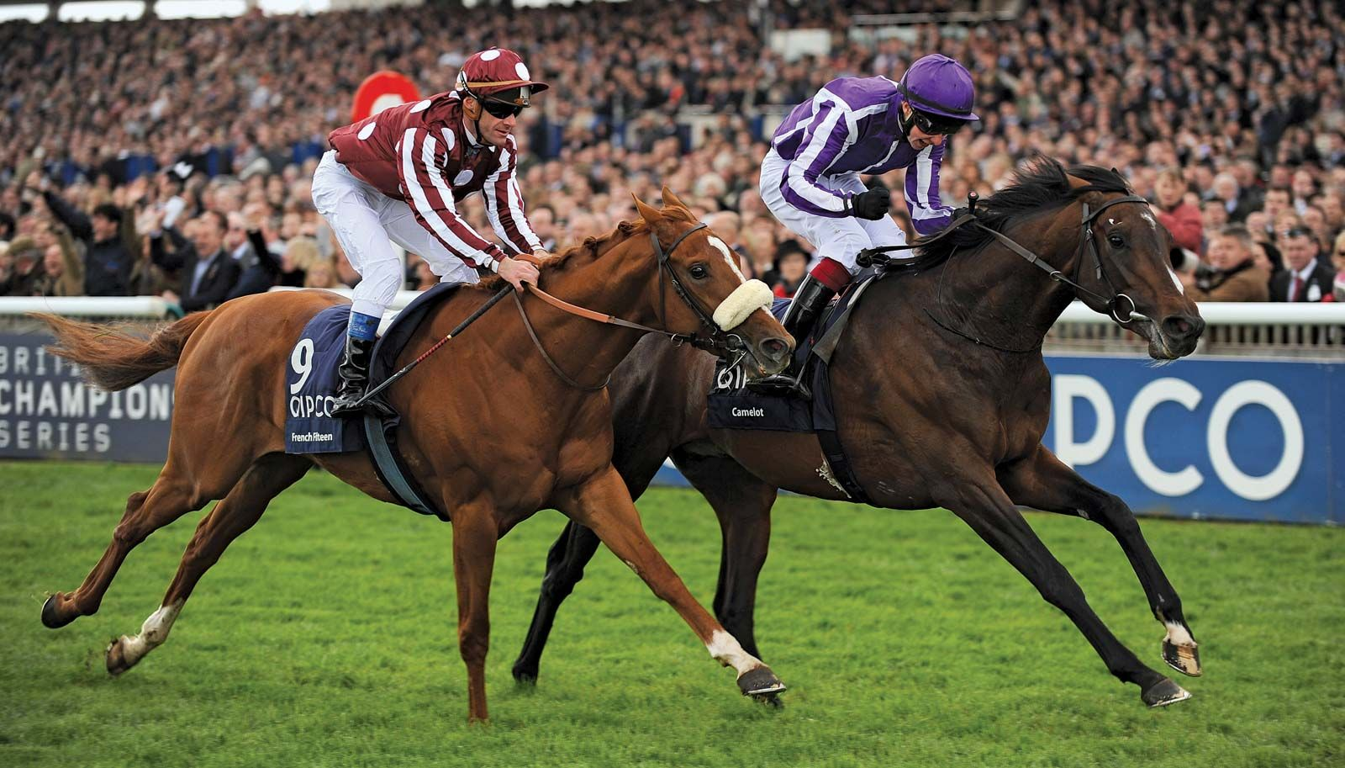

Stable Matching problem
Thanks Prof. Xanda Schofield for the example!
Complete bipartite graph with equal sides:
n horses and n jockeys
Each horse has a strict, complete preference ordering over jockeys, and vice versa
Want: a stable matching
Stable matching: No unmatched horse and jockey both prefer each other to their current matches

Slide 6



Example preference profiles
>
>
Alice
Bob
Eve
Donkey
Spirit
Swiftwind

Slide 7
Example preference profiles
>
>
Alice | Donkey | Spirit | Swiftwind
Bob | Spirit | Donkey | Swiftwind
Eve | Donkey | Spirit | Swiftwind
Donkey | Bob | Alice | Eve
Spirit | Alice | Bob | Eve
Swiftwind | Alice | Bob | Eve

Slide 8
Example matching #1
Alice | Donkey | Spirit | Swiftwind
Bob | Spirit | Donkey | Swiftwind
Eve | Donkey | Spirit | Swiftwind
Donkey | Bob | Alice | Eve
Spirit | Alice | Bob | Eve
Swiftwind | Alice | Bob | Eve
Is this a stable matching?

Slide 9
Example matching #1
Alice | Donkey | Spirit | Swiftwind
Bob | Spirit | Donkey | Swiftwind
Eve | Donkey | Spirit | Swiftwind
Donkey | Bob | Alice | Eve
Spirit | Alice | Bob | Eve
Swiftwind | Alice | Bob | Eve
No.
Alice and Spirit form a blocking pair.

Slide 10
Example matching #2
Alice | Donkey | Spirit | Swiftwind
Bob | Spirit | Donkey | Swiftwind
Eve | Donkey | Spirit | Swiftwind
Donkey | Bob | Alice | Eve
Spirit | Alice | Bob | Eve
Swiftwind | Alice | Bob | Eve
What about this matching?

Slide 11
Example matching #2
Alice | Donkey | Spirit | Swiftwind
Bob | Spirit | Donkey | Swiftwind
Eve | Donkey | Spirit | Swiftwind
Donkey | Bob | Alice | Eve
Spirit | Alice | Bob | Eve
Swiftwind | Alice | Bob | Eve
Yes!
(Swiftwind and Eve are unhappy, but helpless.)

Slide 12
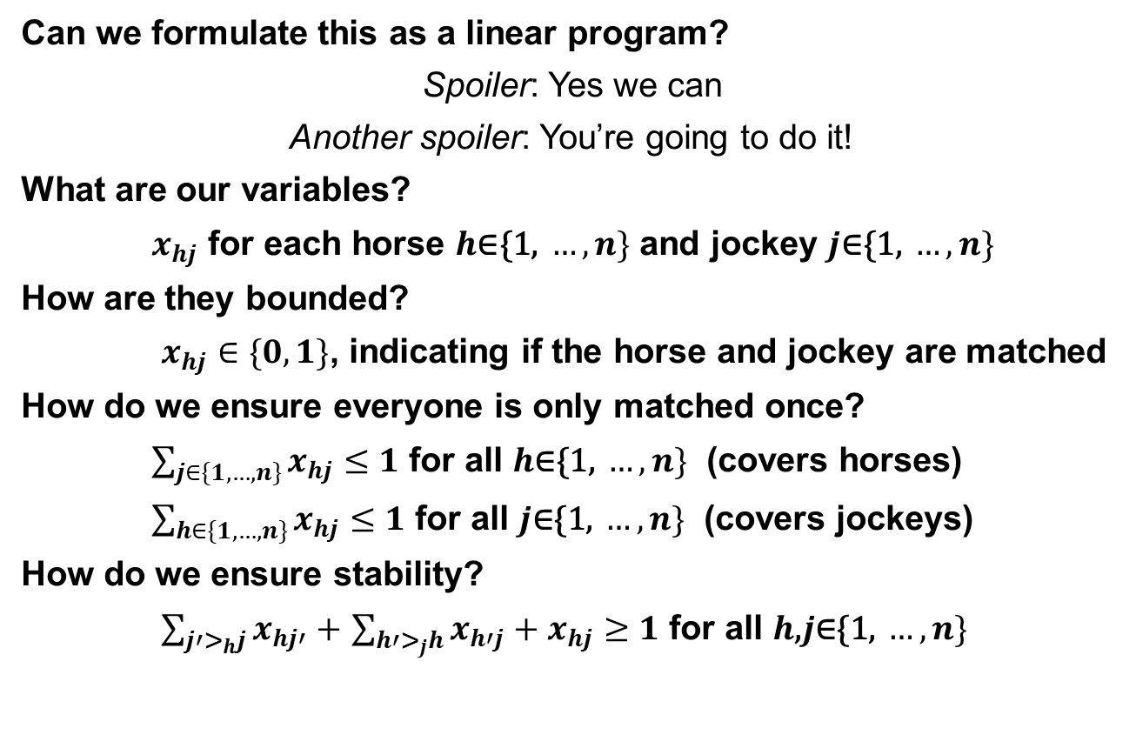
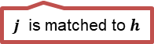
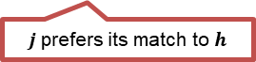
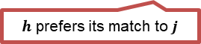
Throwback Monday: Int. Linear Programs
Can we formulate this as a linear program?
Spoiler: Yes we can
Another spoiler: You’re going to do it!
What are our variables?
$x_{hj}$ for each horse $h\text{∈}\text{\{1, }…, n\}$ and jockey $j\text{∈\{1, }…, n\}$
How are they bounded?
$x_{hj}∈\{0,1\}$, indicating if the horse and jockey are matched
How do we ensure everyone is only matched once?
$\sum_{j∈\{1,…,n\}}{x_{hj}}≤1$ for all $h\text{∈\{1, }…, n\}$ (covers horses)
$\sum_{h∈\{1,…,n\}}{x_{hj}}≤1$ for all $j\text{∈\{1, }…, n\}$ (covers jockeys)
How do we ensure stability?
$\sum_{j′>_{h}j}{x_{hj′}}+$ $\sum_{h′>_{j}h}{x_{h′j}}+x_{hj}≥1$ for all $h\text{,}j\text{∈\{1, }…, n\}$
$h$ prefers its match to $j$
OR
$j$prefers its match to $h$
OR
$j$ is matched to $h$
Notes:
e

Slide 13
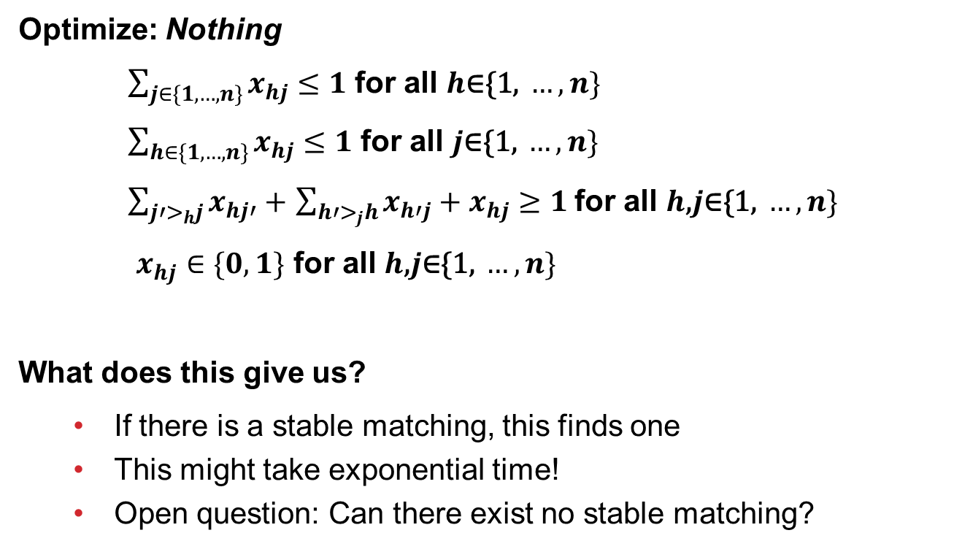
Throwback Monday: Int. Linear Programs
Optimize: Nothing
$\sum_{j∈\{1,…,n\}}{x_{hj}}≤1$ for all $h\text{∈\{1, }…, n\}$
$\sum_{h∈\{1,…,n\}}{x_{hj}}≤1$ for all $j\text{∈\{1, }…, n\}$
$\sum_{j′>_{h}j}{x_{hj′}}+$ $\sum_{h′>_{j}h}{x_{h′j}}+x_{hj}≥1$for all $h\text{,}j\text{∈\{1, }…, n\}$
$x_{hj}∈\{0,1\}$ for all $h\text{,}j\text{∈\{1, }…, n\}$
What does this give us?
If there is a stable matching, this finds one
This might take exponential time!
Open question: Can there exist no stable matching?

Slide 14
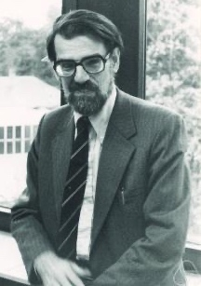
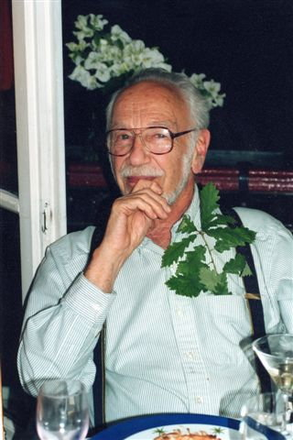

Some questions
Does a stable solution to the marriage problem always exist?
Can we compute such a solution efficiently?
Can we compute the best stable solution efficiently?
Hmm …
Hmm …
Lloyd Shapley
David Gale

Slide 15

Gale-Shapley [1962]
Idea: men propose to women

Slide 16

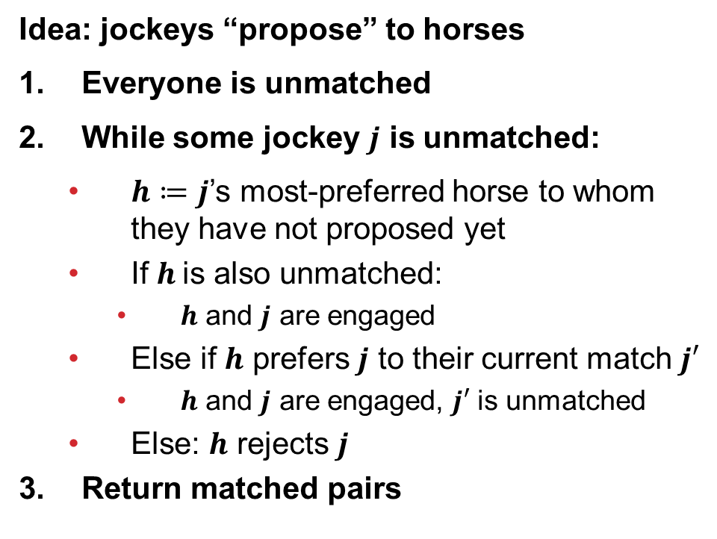
Gale-Shapley [1962]
Idea: jockeys “propose” to horses
Everyone is unmatched
While some jockey $j$ is unmatched:
$h≔j$’s most-preferred horse to whom they have not proposed yet
If $h$is also unmatched:
$h$ and $j$ are engaged
Else if $h$ prefers $j$ to their current match $j′$
$h$ and $j$ are engaged, $j′$ is unmatched
Else: $h$ rejects $j$
Return matched pairs

Slide 17
Running GS
>
>
Alice | Donkey | Spirit | Swiftwind
Bob | Spirit | Donkey | Swiftwind
Eve | Donkey | Spirit | Swiftwind
Donkey | Bob | Alice | Eve
Spirit | Alice | Bob | Eve
Swiftwind | Alice | Bob | Eve

Slide 18
Running GS
>
>
Alice | Donkey | Spirit | Swiftwind
Bob | Spirit | Donkey | Swiftwind
Eve | Donkey | Spirit | Swiftwind
Donkey | Bob | Alice | Eve
Spirit | Alice | Bob | Eve
Swiftwind | Alice | Bob | Eve

Slide 19
Running GS
>
>
Alice | Donkey | Spirit | Swiftwind
Bob | Spirit | Donkey | Swiftwind
Eve | Donkey | Spirit | Swiftwind
Donkey | Bob | Alice | Eve
Spirit | Alice | Bob | Eve
Swiftwind | Alice | Bob | Eve

Slide 20
Running GS
>
>
Alice | Donkey | Spirit | Swiftwind
Bob | Spirit | Donkey | Swiftwind
Eve | Donkey | Spirit | Swiftwind
Donkey | Bob | Alice | Eve
Spirit | Alice | Bob | Eve
Swiftwind | Alice | Bob | Eve

Slide 21
Running GS
>
>
Alice | Donkey | Spirit | Swiftwind
Bob | Spirit | Donkey | Swiftwind
Eve | Donkey | Spirit | Swiftwind
Donkey | Bob | Alice | Eve
Spirit | Alice | Bob | Eve
Swiftwind | Alice | Bob | Eve

Slide 22
Running GS
>
>
Alice | Donkey | Spirit | Swiftwind
Bob | Spirit | Donkey | Swiftwind
Eve | Donkey | Spirit | Swiftwind
Donkey | Bob | Alice | Eve
Spirit | Alice | Bob | Eve
Swiftwind | Alice | Bob | Eve

Slide 23
Running GS
>
>
Alice | Donkey | Spirit | Swiftwind
Bob | Spirit | Donkey | Swiftwind
Eve | Donkey | Spirit | Swiftwind
Donkey | Bob | Alice | Eve
Spirit | Alice | Bob | Eve
Swiftwind | Alice | Bob | Eve

Slide 24
Claim
GS terminates in polynomial time (at most n² iterations of the outer loop)
Proof:
Each iteration, one jockey proposes to someone to whom they have never proposed before
n horses, n jockeys → n×n possible events
(Can tighten a bit to n(n - 1) + 1 iterations.)

Slide 25
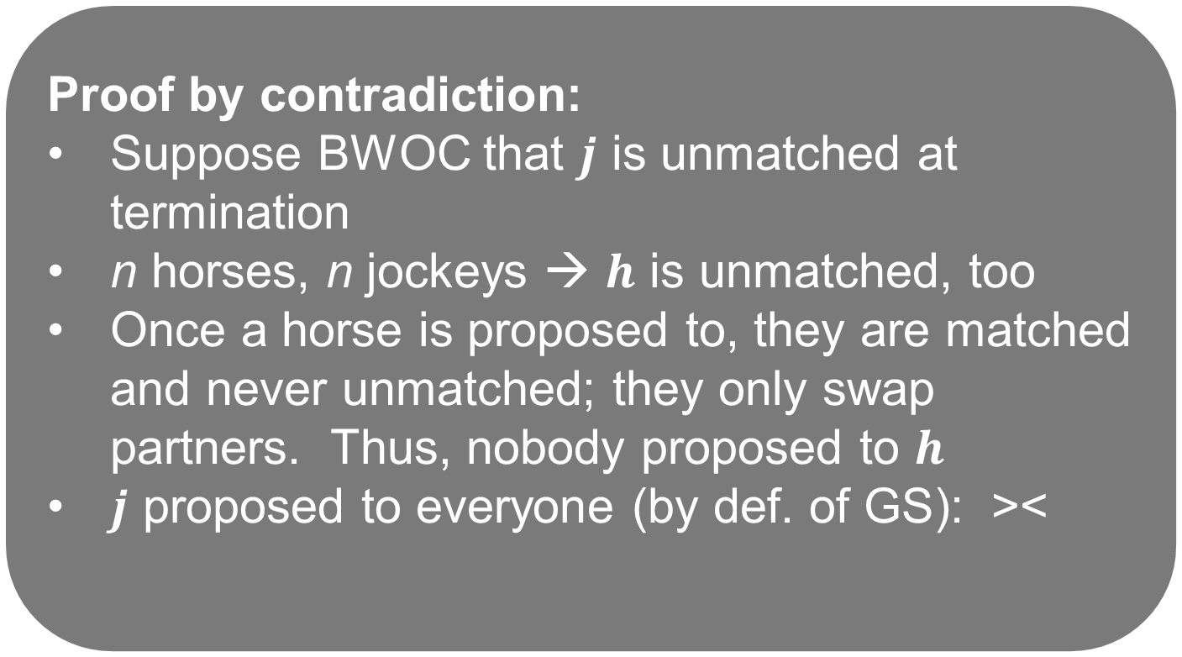
Claim
GS results in a perfect matching
Proof by contradiction:
Suppose BWOC that $j$ is unmatched at termination
n horses, n jockeys → $h$ is unmatched, too
Once a horse is proposed to, they are matched and never unmatched; they only swap partners. Thus, nobody proposed to $h$
$j$ proposed to everyone (by def. of GS): ><

Slide 26
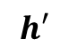
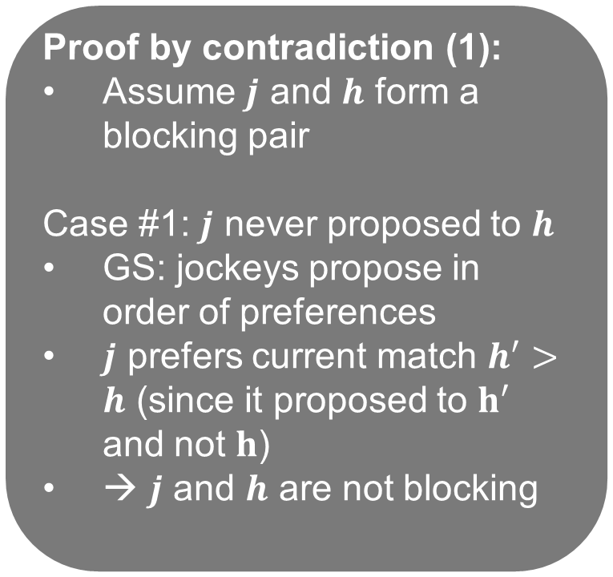
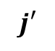
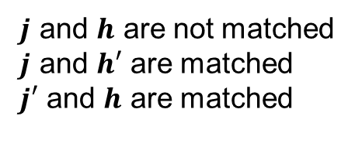
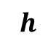
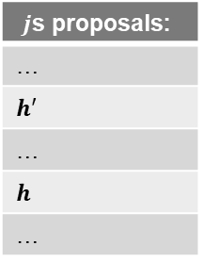
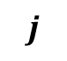
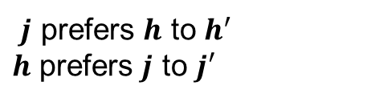
Claim
GS results in a stable matching (i.e., there are no blocking pairs)
Proof by contradiction (1):
Assume $j$ and $h$ form a blocking pair
Case #1: $j$ never proposed to $h$
GS: jockeys propose in order of preferences
$j$ prefers current match $h^{′}>h$ (since it proposed to $h^{′}$ and not $h$)
→ $j$ and $h$ are not blocking
$j$ and $h$ are not matched
$j$ and $h′$ are matched
$j′$ and $h$ are matched
$$j$$
$$h$$
$$j′$$
$$h′$$
$j$ prefers $h$ to $h^{′}$
$h$ prefers $j$ to $j′$
$j$s proposals:
…
$$h′$$
…
$$h$$
…

Slide 27
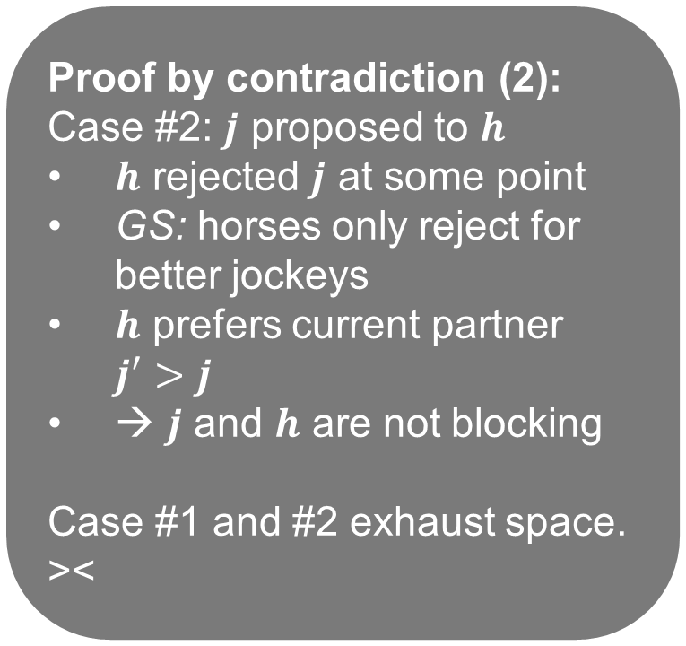
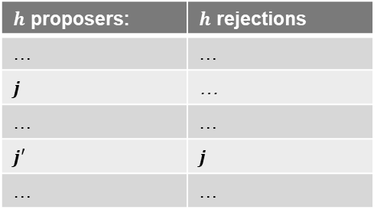
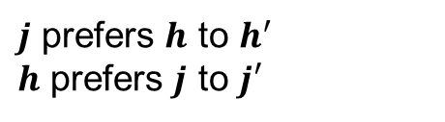
Claim
GS results in a stable matching (i.e., there are no blocking pairs)
Proof by contradiction (2):
Case #2: $j$ proposed to $h$
$h$ rejected $j$ at some point
GS: horses only reject for better jockeys
$h$ prefers current partner $j^{′}>j$
→ $j$ and $h$ are not blocking
Case #1 and #2 exhaust space. ><
$j$ and $h$ are not matched
$j$ and $h′$ are matched
$j′$ and $h$ are matched
$$j$$
$$h$$
$$j′$$
$$h′$$
$j$ prefers $h$ to $h^{′}$
$h$ prefers $j$ to $j′$
$h$ proposers: | $h$ rejections
… | …
$$j$$ | …
… | …
$$j′$$ | $$j$$
… | …

Slide 28

Recap: Some questions
Does a stable solution to the marriage problem always exist?
Can we compute such a solution efficiently?
Can we compute the best stable solution efficiently?
We’ll look at a specific notion of “the best” – optimality with respect to one side of the market

Slide 29
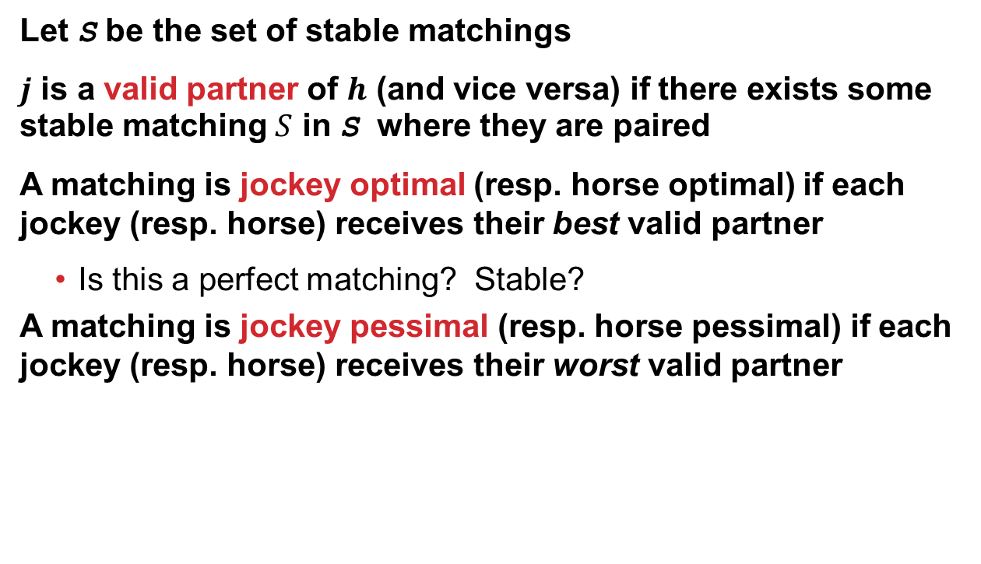
Horse/Jockey optimality/pessimality
Let S be the set of stable matchings
$j$ is a valid partner of $h$ (and vice versa) if there exists some stable matching $S$ in S where they are paired
A matching is jockey optimal (resp. horse optimal) if each jockey (resp. horse) receives their best valid partner
Is this a perfect matching? Stable?
A matching is jockey pessimal (resp. horse pessimal) if each jockey (resp. horse) receives their worst valid partner

Slide 30
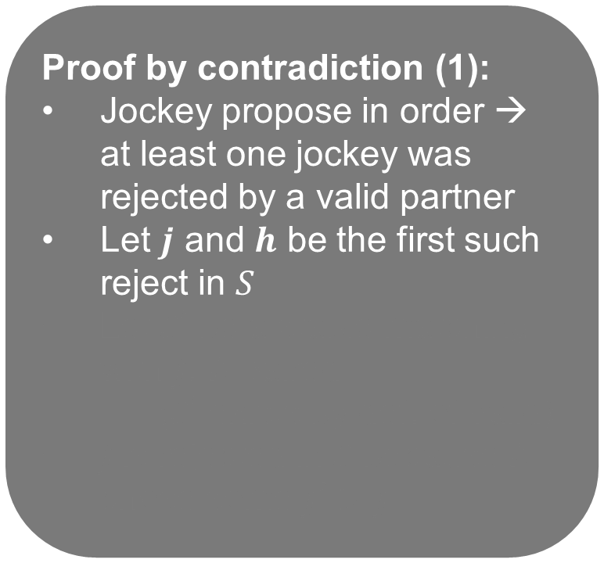
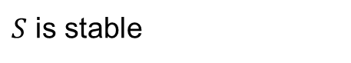
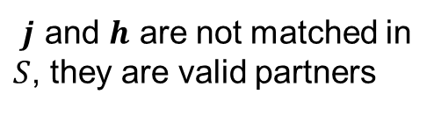
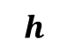
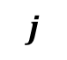
Claim
GS – with the jockey proposing – results in a jockey-optimal matching
Proof by contradiction (1):
Jockey propose in order → at least one jockey was rejected by a valid partner
Let $j$ and $h$ be the first such reject in $S$
Let $S′$ be a stable matching with $j$, $h$ paired
($S′$ exists by def. of valid)
$j$is rejected in $S$ because $h$ chose some $j^{′}>j$
$j$ and $h$ are not matched in $S$, they are valid partners
$$j$$
$$h$$
$S$ is stable

Slide 31
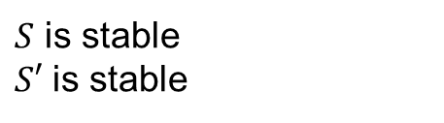
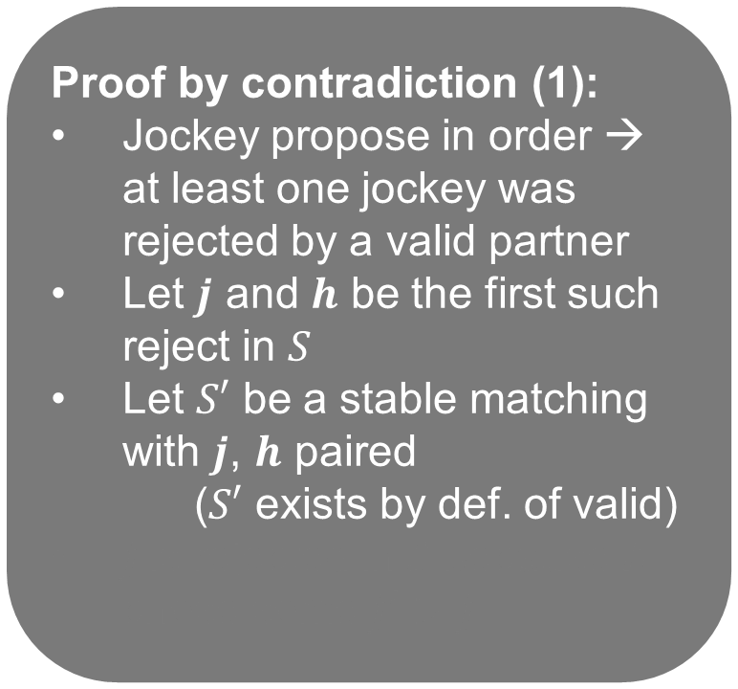
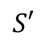
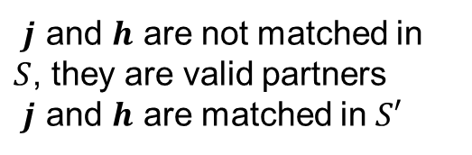
Claim
GS – with the jockey proposing – results in a jockey-optimal matching
Proof by contradiction (1):
Jockey propose in order → at least one jockey was rejected by a valid partner
Let $j$ and $h$ be the first such reject in $S$
Let $S′$ be a stable matching with $j$, $h$ paired
($S′$ exists by def. of valid)
$j$is rejected in $S$ because $h$ chose some $j^{′}>j$
$j$ and $h$ are not matched in $S$, they are valid partners
$j$ and $h$ are matched in $S′$
$$S′$$
$$j$$
$$h$$
$S$ is stable
$S′$ is stable

Slide 32
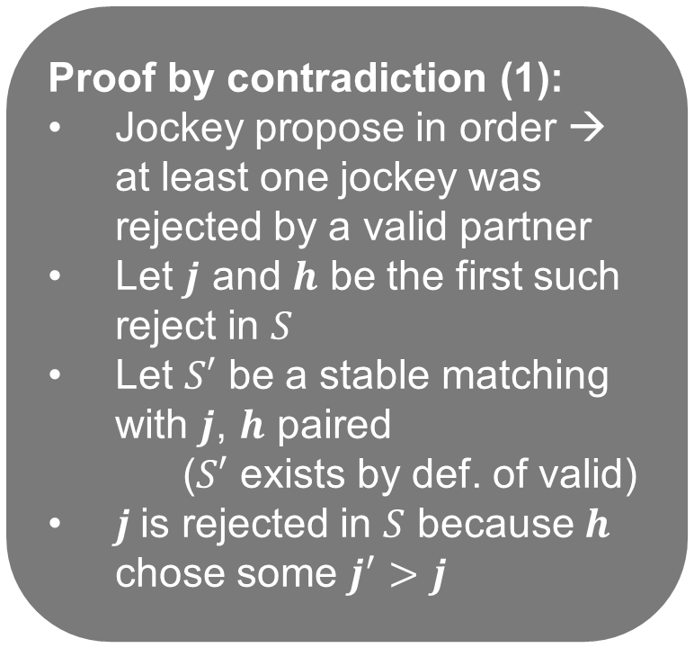
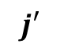
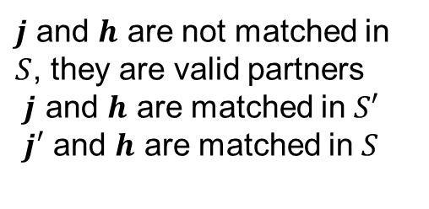
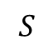
Claim
GS – with the jockey proposing – results in a jockey-optimal matching
Proof by contradiction (1):
Jockey propose in order → at least one jockey was rejected by a valid partner
Let $j$ and $h$ be the first such reject in $S$
Let $S′$ be a stable matching with $j$, $h$ paired
($S′$ exists by def. of valid)
$j$is rejected in $S$ because $h$ chose some $j^{′}>j$
$j$ and $h$ are not matched in $S$, they are valid partners
$j$ and $h$ are matched in $S′$
$j′$ and $h$ are matched in $S$
$$S′$$
$$j$$
$$h$$
$$S$$
$$j′$$
$S$ is stable
$S′$ is stable

Slide 33
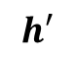
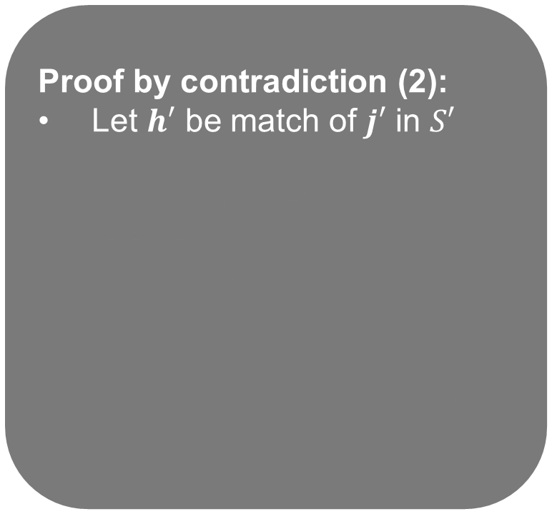
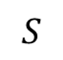
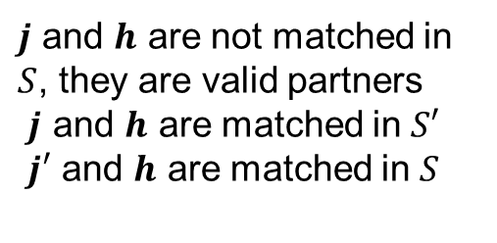
Claim
GS – with the jockey proposing – results in a jockey-optimal matching
Proof by contradiction (2):
Let $h′$ be match of $j′$ in $S′$
$j′$ was not rejected by valid partner in $S$ before $j$ was rejected by $h$ (by assump.)
→ $j^{′}$ prefers $h$ to $h′$
Know $h$ prefers $j^{′}$ over $j$, their jockey in $S′$
→ $j′$ and $h$ form a blocking pair in $S′$ ><
$j$ and $h$ are not matched in $S$, they are valid partners
$j$ and $h$ are matched in $S′$
$j′$ and $h$ are matched in $S$
$$S′$$
$$j$$
$$h$$
$$S$$
$$j′$$
$$S$$
$$h′$$
$S$ is stable
$S′$ is stable

Slide 34
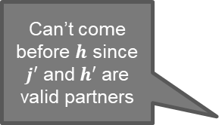
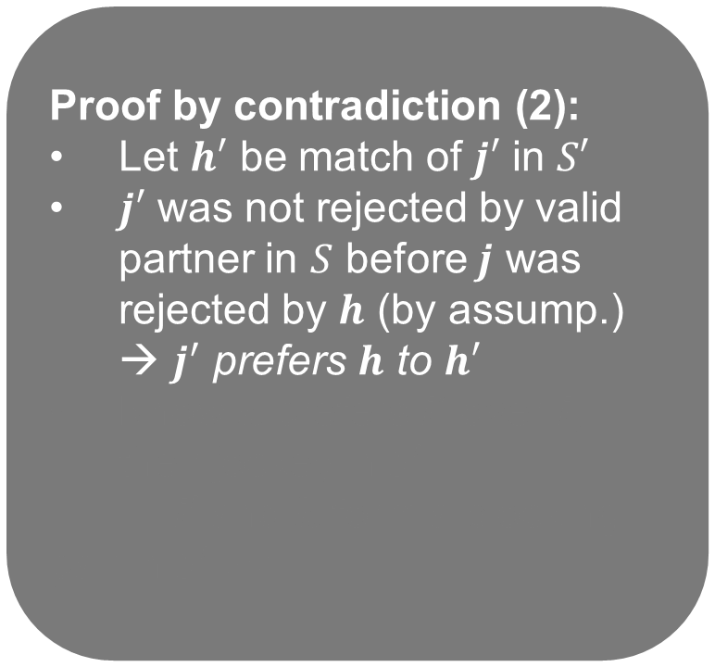
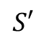
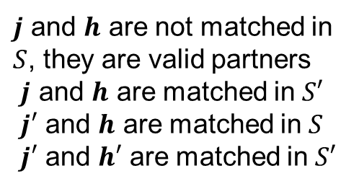
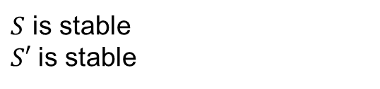
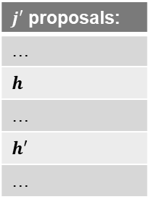
Claim
GS – with the jockey proposing – results in a jockey-optimal matching
Proof by contradiction (2):
Let $h′$ be match of $j′$ in $S′$
$j′$ was not rejected by valid partner in $S$ before $j$ was rejected by $h$ (by assump.)
→ $j^{′}$ prefers $h$ to $h′$
Know $h$ prefers $j^{′}$ over $j$, their jockey in $S′$
→ $j′$ and $h$ form a blocking pair in $S′$ ><
$j$ and $h$ are not matched in $S$, they are valid partners
$j$ and $h$ are matched in $S′$
$j′$ and $h$ are matched in $S$
$j′$ and $h′$ are matched in $S′$
$$S′$$
$$j$$
$$h$$
$$S$$
$$j′$$
$$S′$$
$$h′$$
$S$ is stable
$S′$ is stable
$j′$ proposals:
…
$$h$$
…
$$h′$$
…
Can’t come before $h$ since $j′$ and $h′$ are valid partners

Slide 35

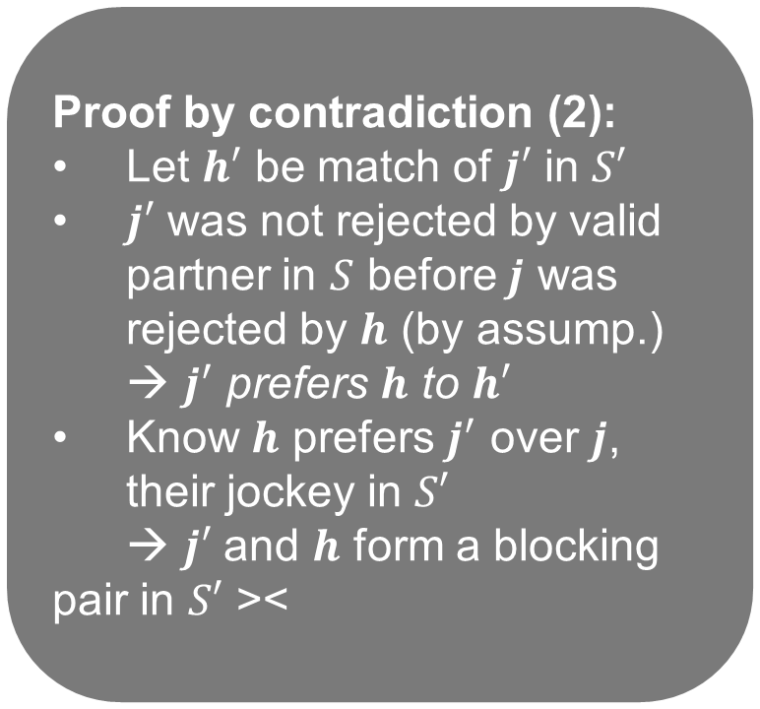
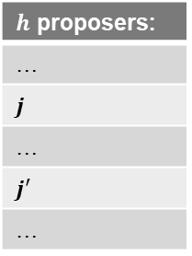
Claim
GS – with the jockey proposing – results in a jockey-optimal matching
Proof by contradiction (2):
Let $h′$ be match of $j′$ in $S′$
$j′$ was not rejected by valid partner in $S$ before $j$ was rejected by $h$ (by assump.)
→ $j^{′}$ prefers $h$ to $h′$
Know $h$ prefers $j^{′}$ over $j$, their jockey in $S′$
→ $j′$ and $h$ form a blocking pair in $S′$ ><
$j$ and $h$ are not matched in $S$, they are valid partners
$j$ and $h$ are matched in $S′$
$j′$ and $h$ are matched in $S$
$j′$ and $h′$ are matched in $S′$
$$S′$$
$$j$$
$$h$$
$$S$$
$$j′$$
$$S′$$
$$h′$$
$S$ is stable
$S′$ is stable
$h$ proposers:
…
$$j$$
…
$$j^{′}$$
…
$j′$ proposals:
…
$$h$$
…
$$h′$$
…

Slide 36
Recap: Some questions
Does a stable solution to the marriage problem always exist?
Can we compute such a solution efficiently?
Can we compute the best stable solution efficiently?
*
For one side of the market. What about the other side?

Slide 37
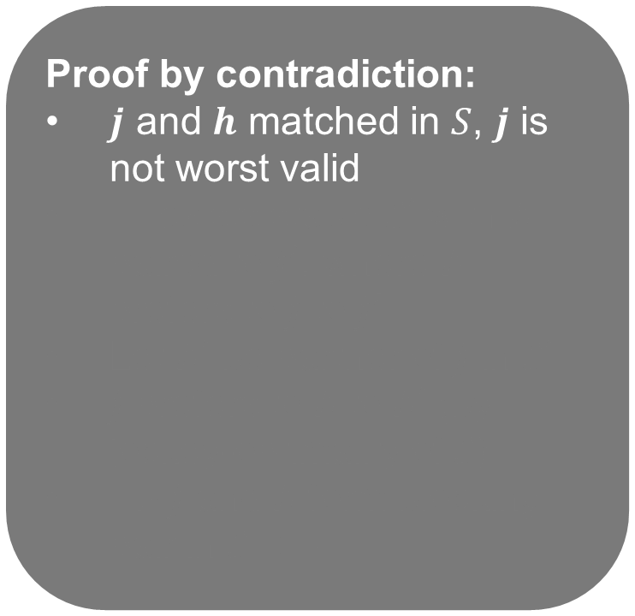
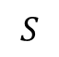
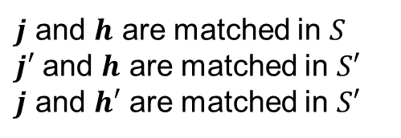
Claim
GS – with the jockey proposing – results in a horse-pessimal matching
Proof by contradiction:
$j$ and $h$ matched in $S$, $j$ is not worst valid
→ exists stable $S′$ with $h$ paired to $j^{′}$, where $h$ prefers to $j$ to $j^{′}$
Let $h′$ be partner of $j$ in $S′$
$j$ prefers to $h$ to $h′$ (by jockey-optimality of $S$)
→ $j$ and $h$ form blocking pair in $S$’ ><
$j$ and $h$ are matched in $S$
$j′$ and $h$ are matched in $S′$
$j$ and $h′$ are matched in $S′$
$$S$$
$$j$$
$$h$$

Slide 38


Claim
GS – with the jockey proposing – results in a horse-pessimal matching
Proof by contradiction:
$j$ and $h$ matched in $S$, $j$ is not worst valid
→ exists stable $S′$ with $h$ paired to $j^{′}$, where $h$ prefers to $j$ to $j^{′}$
Let $h′$ be partner of $j$ in $S′$
$j$ prefers to $h$ to $h′$ (by jockey-optimality of $S$)
→ $j$ and $h$ form blocking pair in $S$’ ><
$j$ and $h$ are matched in $S$
$j′$ and $h$ are matched in $S′$
$j$ and $h′$ are matched in $S′$
$$S$$
$$j$$
$$h$$
$$S′$$
$$j′$$

Slide 39


Claim
GS – with the jockey proposing – results in a horse-pessimal matching
Proof by contradiction:
$j$ and $h$ matched in $S$, $j$ is not worst valid
→ exists stable $S′$ with $h$ paired to $j^{′}$, where $h$ prefers to $j$ to $j^{′}$
Let $h′$ be partner of $j$ in $S′$
$j$ prefers to $h$ to $h′$ (by jockey-optimality of $S$)
→ $j$ and $h$ form blocking pair in $S$’ ><
$j$ and $h$ are matched in $S$
$j′$ and $h$ are matched in $S′$
$j$ and $h′$ are matched in $S′$
$$S$$
$$j$$
$$h$$
$$S′$$
$$j′$$
$$S′$$
$$h′$$

Slide 40

Claim
GS – with the jockey proposing – results in a horse-pessimal matching
Proof by contradiction:
$j$ and $h$ matched in $S$, $j$ is not worst valid
→ exists stable $S′$ with $h$ paired to $j^{′}$, where $h$ prefers to $j$ to $j^{′}$
Let $h′$ be partner of $j$ in $S′$
$j$ prefers to $h$ to $h′$ (by jockey-optimality of $S$)
→ $j$ and $h$ form blocking pair in $S$’ ><
$j$ and $h$ are matched in $S$
$j′$ and $h$ are matched in $S′$
$j$ and $h′$ are matched in $S′$
$$S$$
$$j$$
$$h$$
$$S′$$
$$j′$$
$$S′$$
$$h′$$

Slide 41

Claim
GS – with the jockey proposing – results in a horse-pessimal matching
Proof by contradiction:
$j$ and $h$ matched in $S$, $j$ is not worst valid
→ exists stable $S′$ with $h$ paired to $j^{′}$, where $h$ prefers to $j$ to $j^{′}$
Let $h′$ be partner of $j$ in $S′$
$j$ prefers to $h$ to $h′$ (by jockey-optimality of $S$)
→ $j$ and $h$ form blocking pair in $S$’ ><
$j$ and $h$ are matched in $S$
$j′$ and $h$ are matched in $S′$
$j$ and $h′$ are matched in $S′$
$$S$$
$$j$$
$$h$$
$$S′$$
$$j′$$
$$S′$$
$$h′$$

Slide 42
Incentive issues
Can either side benefit by misreporting?
(Slight extension for rest of talk: participants can mark possible matches as unacceptable – a form of preference list truncation)
Any algorithm that yields a jockey- (horse-)optimal matching → truthful revelation by jockeys (horses) is dominant strategy [Roth 1982]

Slide 43
In GS with jockey proposing, horses can benefit by misreporting preferences
Truthful reporting
Alice | Donkey | Spirit
Bob | Spirit | Donkey
Donkey | Bob | Alice
Spirit | Alice | Bob
Alice | Donkey | Spirit
Bob | Spirit | Donkey
Donkey | Bob | Alice
Spirit | Alice | Bob
Strategic reporting
Alice | Donkey | Spirit
Bob | Spirit | Donkey
Donkey | Bob | 
Spirit | Alice | Bob
Alice | Donkey | Spirit
Bob | Spirit | Donkey
Donkey | Bob | 
Spirit | Alice | Bob

Slide 44
Claim
There is no matching mechanism that:
is strategy proof (for both sides); and
always results in a stable outcome (given revealed preferences)

Slide 45
Extensions to stable Matching

Slide 46

Imbalance [Ashlagi et al. 2013]
What if we have n jockeys and n’ ≠ n horses?
How does this affect participants? Core size?
Being on short side of market: good!
W.h.p., short side get rank ~log(n)
… long side gets rank ~random
Jockey avg rank of matches
# jockeys
# horses held constant at n’ = 40

Slide 47

Imbalance [Ashlagi et al. 2013]
Not many stable matchings with even small imbalances in the market
Avg percent of matched jockeys with multiple stable partners
# jockeys

Slide 48

Imbalance [Ashlagi et al. 2013]
“Rural hospital theorem” [Roth 1986]:
The set of jockeys and horses that are unmatched is the same for all stable matchings
Assume n jockeys, n+1 horses
One horse $h$ unmatched in all stable matchings
→ Drop $h$, same stable matchings
Take stable matchings with n horses
Stay stable when we add in $h$ if no jockeys prefer $h$ to their current match
→ average rank of jockey’s matches is low
Notes:
Rural hospitals: worried it would hurt rural hospitals (places people don’t like) because rural hospitals didn’t appear frequently in the stable matchings, but this shows they wouldn’t appear in any stable matchings if they didn’t appear in an outcome
Given few jockeys, horses will be matched only if one jockey likes them enough, so as we add horses jockeys will still get the same average ranked match which is why their average match is low when htye are the smaller side

Slide 49

Online arrival [Khuller et al. 1993]
Random preferences, jockeys arrive over time, once matched nobody can switch
Algorithm: match $j$ to highest-ranked free $h$
On average, O(nlog(n)) unstable pairs
No deterministic or randomized algorithm can do better than Ω(n²) unstable pairs!
Not better with randomization ☹
Notes:
It’s hard enough to get a wholly stable matching, let alone one with few unstable pairs

Slide 50

Incomplete prefs [Manlove et al. 2002]
Before: complete + strict preferences
Easy to compute, lots of nice properties
Incomplete preferences
May exist: stable matchings of different sizes
Everything becomes hard!
Finding max or min cardinality stable matching
Determining if < $j$, $h$> are stable
Finding/approx. finding “egalitarian” matching
Notes:
TIES!

Slide 51
Non-bipartite graph …?
Matching is defined on general graphs:
“Set of edges, each vertex included at most once”
The stable roommates problem is bipartite stable matching generalized to any graph
Each vertex ranks all n-1 other vertices
(Variations with/without truncation)
Same notion of stability

Slide 52

Is this different than Bipartite stable Matching?
>
>
Alana | Brian | Cynthia | Dracula
Brian | Cynthia | Alana | Dracula
Cynthia | Alana | Brian | Dracula
Dracula | (Anyone) | (Anyone) | (Anyone)
No stable matching exists!
Anyone paired with Dracula (i) prefers some other v and (ii) is preferred by that v

Slide 53

Hopeless?
Can we build an algorithm that:
Finds a stable matching; or
Reports nonexistence
… In polynomial time?
Yes! [Irving 1985]
Builds on Gale-Shapley ideas and work by McVitie and Wilson [1971]
Hmm …
Notes:
Donald kKnuth posed the question of if we can do it in p-time

Slide 54
Irving’s algorithm: Phase 1
Idea: Run an algorithm very similar to Gale-Shapley
Everyone proposes to everyone
Individuals hold 2 types of temporary matches: matches where they propose and matches where they are proposed to (the former will be weakly better)
After this step: one person is unmatched → nonexistence
Else: create a reduced set of preferences
a holds proposal from b → a truncates all x after b
For each removed x, also remove a from x’s preferences
Note: b at end of a’s list → a at start of b’s list
If any reduced set is empty: nonexistence
Else: this is a “stable table” – continue to Phase 2

Slide 55
Running the algorithm: Phase 1
Example from: https://www.youtube.com/watch?v=9Lo7TFAkohE&ab_channel=OscarRobertson
>
>
>
>
Alice | Bob | Dave | Frank | Eve | Carol
Bob | Eve | Carol | Frank | Dave | Alice
Carol | Bob | Frank | Eve | Alice | Dave
Dave | Carol | Alice | Frank | Bob | Eve
Eve | Bob | Alice | Frank | Carol | Dave
Frank | Alice | Dave | Eve | Carol | Bob
Green = Locked proposal from self
Blue = Locked proposal to self
Yellow = Currently proposing
Orange = Currently being proposed to

Slide 56
Running the algorithm: Phase 1
>
>
>
>
Alice | Bob | Dave | Frank | Eve | Carol
Bob | Eve | Carol | Frank | Dave | Alice
Carol | Bob | Frank | Eve | Alice | Dave
Dave | Carol | Alice | Frank | Bob | Eve
Eve | Bob | Alice | Frank | Carol | Dave
Frank | Alice | Dave | Eve | Carol | Bob
Green = Locked proposal from self
Blue = Locked proposal to self
Yellow = Currently proposing
Orange = Currently being proposed to

Slide 57
Running the algorithm: Phase 1
>
>
>
>
Alice | Bob | Dave | Frank | Eve | Carol
Bob | Eve | Carol | Frank | Dave | Alice
Carol | Bob | Frank | Eve | Alice | Dave
Dave | Carol | Alice | Frank | Bob | Eve
Eve | Bob | Alice | Frank | Carol | Dave
Frank | Alice | Dave | Eve | Carol | Bob
Green = Locked proposal from self
Blue = Locked proposal to self
Yellow = Currently proposing
Orange = Currently being proposed to

Slide 58
Running the algorithm: Phase 1
>
>
>
>
Alice | Bob | Dave | Frank | Eve | Carol
Bob | Eve | Carol | Frank | Dave | Alice
Carol | Bob | Frank | Eve | Alice | Dave
Dave | Carol | Alice | Frank | Bob | Eve
Eve | Bob | Alice | Frank | Carol | Dave
Frank | Alice | Dave | Eve | Carol | Bob
Green = Locked proposal from self
Blue = Locked proposal to self
Yellow = Currently proposing
Orange = Currently being proposed to

Slide 59
Running the algorithm: Phase 1
>
>
>
>
Alice | Bob | Dave | Frank | Eve | Carol
Bob | Eve | Carol | Frank | Dave | Alice
Carol | Bob | Frank | Eve | Alice | Dave
Dave | Carol | Alice | Frank | Bob | Eve
Eve | Bob | Alice | Frank | Carol | Dave
Frank | Alice | Dave | Eve | Carol | Bob
Green = Locked proposal from self
Blue = Locked proposal to self
Yellow = Currently proposing
Orange = Currently being proposed to

Slide 60
Running the algorithm: Phase 1
>
>
>
>
Alice | Bob | Dave | Frank | Eve | Carol
Bob | Eve | Carol | Frank | Dave | Alice
Carol | Bob | Frank | Eve | Alice | Dave
Dave | Carol | Alice | Frank | Bob | Eve
Eve | Bob | Alice | Frank | Carol | Dave
Frank | Alice | Dave | Eve | Carol | Bob
Green = Locked proposal from self
Blue = Locked proposal to self
Yellow = Currently proposing
Orange = Currently being proposed to

Slide 61
Running the algorithm: Phase 1
>
>
>
>
Alice |  | Dave | Frank | Eve | Carol
Bob | Eve | Carol | Frank | Dave
Carol | Bob | Frank | Eve | Alice | Dave
Dave | Carol | Alice | Frank | Bob | Eve
Eve | Bob | Alice | Frank | Carol | Dave
Frank | Alice | Dave | Eve | Carol | Bob
Green = Locked proposal from self
Blue = Locked proposal to self
Yellow = Currently proposing
Orange = Currently being proposed to

Slide 62
Running the algorithm: Phase 1
>
>
>
>
Alice |  | Dave | Frank | Eve | Carol
Bob | Eve | Carol | Frank | Dave
Carol | Bob | Frank | Eve | Alice | Dave
Dave | Carol | Alice | Frank | Bob | Eve
Eve | Bob | Alice | Frank | Carol | Dave
Frank | Alice | Dave | Eve | Carol | Bob
Green = Locked proposal from self
Blue = Locked proposal to self
Yellow = Currently proposing
Orange = Currently being proposed to

Slide 63
Running the algorithm: Phase 1
>
>
>
>
Alice |  | Dave | Frank | Eve | Carol
Bob | Eve | Carol | Frank | Dave
Carol | Bob | Frank | Eve | Alice | Dave
Dave | Carol | Alice | Frank | Bob | Eve
Eve | Bob | Alice | Frank | Carol | Dave
Frank | Alice | Dave | Eve | Carol | Bob
Green = Locked proposal from self
Blue = Locked proposal to self
Yellow = Currently proposing
Orange = Currently being proposed to

Slide 64
Running the algorithm: Phase 1
>
>
>
>
Alice |  | Dave | Frank | Eve | Carol
Bob | Eve | Carol | Frank | Dave
Carol | Bob | Frank | Eve | Alice | Dave
Dave | Carol | Alice | Frank | Bob | Eve
Eve | Bob | Alice | Frank | Carol | Dave
Frank | Alice | Dave | Eve | Carol | Bob
Green = Locked proposal from self
Blue = Locked proposal to self
Yellow = Currently proposing
Orange = Currently being proposed to

Slide 65
Running the algorithm: Phase 1
>
>
>
>
Alice |  | Dave | Frank | Eve | Carol
Bob | Eve | Carol | Frank | Dave
Carol | Bob | Frank | Eve | Alice | Dave
Dave | Carol | Alice | Frank | Bob | Eve
Eve | Bob | Alice | Frank | Carol | Dave
Frank | Alice | Dave | Eve | Carol | Bob
Green = Locked proposal from self
Blue = Locked proposal to self
Yellow = Currently proposing
Orange = Currently being proposed to

Slide 66
Running the algorithm: Phase 1
>
>
>
>
Alice |  | Dave | Frank | Eve | Carol
Bob | Eve | Carol | Frank | Dave
Carol | Bob | Frank | Eve | Alice | Dave
Dave | Carol | Alice | Frank | Bob | Eve
Eve | Bob | Alice | Frank | Carol | Dave
Frank | Alice | Dave | Eve | Carol | Bob
Green = Locked proposal from self
Blue = Locked proposal to self
Yellow = Currently proposing
Orange = Currently being proposed to

Slide 67
Running the algorithm: Phase 1
>
>
>
>
Alice |  | Dave | Frank | Eve | Carol
Bob | Eve |  | Frank | Dave
Carol |  | Frank | Eve | Alice | Dave
Dave | Carol | Alice | Frank | Bob | Eve
Eve | Bob | Alice | Frank | Carol | Dave
Frank | Alice | Dave | Eve | Carol | Bob
Green = Locked proposal from self
Blue = Locked proposal to self
Yellow = Currently proposing
Orange = Currently being proposed to

Slide 68
Running the algorithm: Phase 1
>
>
>
>
Alice |  | Dave | Frank | Eve | Carol
Bob | Eve |  | Frank | Dave
Carol |  | Frank | Eve | Alice | Dave
Dave | Carol | Alice | Frank | Bob | Eve
Eve | Bob | Alice | Frank | Carol | Dave
Frank | Alice | Dave | Eve | Carol | Bob
Green = Locked proposal from self
Blue = Locked proposal to self
Yellow = Currently proposing
Orange = Currently being proposed to

Slide 69
Running the algorithm: Phase 1
>
>
>
>
Alice |  | Dave | Frank | Eve | Carol
Bob | Eve |  | Frank | Dave
Carol |  | Frank | Eve | Alice | Dave
Dave | Carol | Alice | Frank | Bob | Eve
Eve | Bob | Alice | Frank | Carol | Dave
Frank | Alice | Dave | Eve | Carol | Bob
Green = Locked proposal from self
Blue = Locked proposal to self
Yellow = Currently proposing
Orange = Currently being proposed to

Slide 70
Running the algorithm: Phase 1
>
>
>
>
Alice |  | Dave | Frank | Eve | Carol
Bob | Eve |  | Frank | Dave
Carol |  | Frank | Eve | Alice | Dave
Dave | Carol | Alice | Frank | Bob | Eve
Eve | Bob | Alice | Frank | Carol | Dave
Frank | Alice | Dave | Eve | Carol | Bob
Green = Locked proposal from self
Blue = Locked proposal to self
Yellow = Currently proposing
Orange = Currently being proposed to

Slide 71
Running the algorithm: Phase 1
>
>
>
>
Alice |  | Dave | Frank | Eve | Carol
Bob | Eve |  | Frank | Dave
Carol |  | Frank | Eve | Alice | Dave
Dave | Carol | Alice | Frank | Bob | Eve
Eve | Bob | Alice | Frank | Carol | Dave
Frank | Alice | Dave | Eve | Carol | Bob
Green = Locked proposal from self
Blue = Locked proposal to self
Yellow = Currently proposing
Orange = Currently being proposed to

Slide 72
Running the algorithm: Phase 1
Remove anyone below the proposal offered to you
>
>
>
>
Alice |  | Dave | Frank
Bob | Eve
Carol |  | Frank | Eve | Alice | Dave
Dave | Carol | Alice
Eve | Bob
Frank | Alice | Dave | Eve | Carol
Green = Locked proposal from self
Blue = Locked proposal to self

Slide 73
Running the algorithm: Phase 1
If you are not on someone else’s list, remove them from your list
>
>
>
>
Alice |  | Dave | Frank
Bob | Eve
Carol |  | Frank |  |  | Dave
Dave | Carol | Alice
Eve | Bob
Frank | Alice |  |  | Carol
Green = Locked proposal from self
Blue = Locked proposal to self

Slide 74
Running the algorithm: Phase 1
If you are not on someone else’s list, remove them from your list
>
>
>
>
Alice | Dave | Frank
Bob | Eve
Carol | Frank | Dave
Dave | Carol | Alice
Eve | Bob
Frank | Alice | Carol
Green = Locked proposal from self
Blue = Locked proposal to self

Slide 75
Stable tables
a is first on b’s list iff b is last on a’s
a is not on b’s list iff
b is not on a’s list
a prefers last element on list to b
No reduced list is empty
Note 1: stable table with all lists length 1 is a stable matching
Note 2: any stable subtable of a stable table can be obtained via rotation eliminations
Phase 2!

Slide 76
Irving’s algorithm: Phase 2
Stable table has length 1 lists: return matching
Identify a rotation:
Eliminate it:
b_{i} rejects a_{i+1,} and repeat rotation finding as necessary
If any list becomes empty: nonexistence
If the subtable hits length 1 lists: return matching
(a₀,b₀),(a₁,b₁),…,(a_{k-1},b_{k-1}) such that:
b_{i} is a_{i}’s second preference
a_{i+1} is b_{i}’s last preference
a₀ is b_{k-1}‘s last preference (i.e., we have cycled)

Slide 77
Running the algorithm: Phase 2
(a₀,b₀),(a₁,b₁),…,(a_{k-1},b_{k-1}) such that:
b_{i} is a_{i}’s second preference
a_{i+1} is b_{i}’s last preference
a₀ is b_{k-1}‘s last preference
Alice | Dave | Frank
Bob | Eve
Carol | Frank | Dave
Dave | Carol | Alice
Eve | Bob
Frank | Alice | Carol
a₀
b₀
a₁
b₁
b₁
a₂
b₀
a₁

Slide 78
Running the algorithm: Phase 2
(a₀,b₀),(a₁,b₁),…,(a_{k-1},b_{k-1}) such that:
b_{i} is a_{i}’s second preference
a_{i+1} is b_{i}’s last preference
a₀ is b_{k-1}‘s last preference
Alice | Dave | Frank
Bob | Eve
Carol | Frank | Dave
Dave | Carol | Alice
Eve | Bob
Frank | Alice | Carol
a₀
b₀
a₁
b₁
b₁
a₂
b₀
a₁
Next: b_{i} rejects a_{i+1}

Slide 79
Running the algorithm: Phase 2
(a₀,b₀),(a₁,b₁),…,(a_{k-1},b_{k-1}) such that:
b_{i} is a_{i}’s second preference
a_{i+1} is b_{i}’s last preference
a₀ is b_{k-1}‘s last preference
Alice | Dave | Frank
Bob | Eve
Carol |  | Dave
Dave | Carol | Alice
Eve | Bob
Frank | Alice
a₀
b₀
a₁
b₁
b₁
a₂
b₀
Next: b_{i} rejects a_{i+1}

Slide 80
Running the algorithm: Phase 2
(a₀,b₀),(a₁,b₁),…,(a_{k-1},b_{k-1}) such that:
b_{i} is a_{i}’s second preference
a_{i+1} is b_{i}’s last preference
a₀ is b_{k-1}‘s last preference
Alice |  | Frank
Bob | Eve
Carol |  | Dave
Dave | Carol
Eve | Bob
Frank | Alice
a₀
b₀
a₁
b₁
b₁
b₀
Next: b_{i} rejects a_{i+1}

Slide 81
Claim
Irving’s algorithm for the stable roommates problem terminates in polynomial time – specifically O(n²).
This requires some data structure considerations
Naïve implementation of rotations is ~O(n³)

Slide 82
One-to-many matching
The hospitals/residents problem (aka college/students problem aka admissions problem):
Strict preference rankings from each side
One side (hospitals) can accept q > 1 residents
Also introduced in [Gale and Shapley 1962]
Has seen lots of traction in the real world
E.g., the National Resident Matching Program (NRMP)
Other American, British, and Canadian medical labor markets
Canadian lawyer labor markets
Sororities

Slide 83





History of the NRMP
[Roth 2002]
1900-ish first medical internships
1940’s Fierce competition, eventual market failure
1951 First centralized clearing market
1970s More couples on the market
1995 Crisis of confidence
1996-7 Redesign completed and implemented
Notes:
1950s market failure
Clearinghouse created in early 1950s
mid 1990s crisis of confidence
- American Medical Student Association, Ralph Nader’s Public Citizen Health Research Group, the Medical Student Section of the Amrican Medical Association
1995 Board of Directors commissioned the design of a new algorithm and a study comparing the old and new
1997 Switched to new algorithm
1998 First match successfully completed with new algorithm

Slide 84


NRMP Simplified: A Gale-Shapley Approach
Idea: Hospitals propose to as many doctors as they have open spots. Doctors accept/reject as normal. Repeat until done.
Capacity 3
Capacity 1
Capacity 2

Slide 85
NRMP Simplified: A Gale-Shapley Approach
Idea: Hospitals propose to as many doctors as they have open spots. Doctors accept/reject as normal. Repeat until done.
Capacity 3
Capacity 1
Capacity 2

Slide 86
NRMP Simplified: A Gale-Shapley Approach
Idea: Hospitals propose to as many doctors as they have open spots. Doctors accept/reject as normal. Repeat until done.
Capacity 3
Capacity 2
Capacity 1

Slide 87
NRMP Simplified: A Gale-Shapley Approach
Idea: Hospitals propose to as many doctors as they have open spots. Doctors accept/reject as normal. Repeat until done.
Capacity 3
Capacity 2
Capacity 1

Slide 88
NRMP Simplified: A Gale-Shapley Approach
Idea: Hospitals propose to as many doctors as they have open spots. Doctors accept/reject as normal. Repeat until done.
Capacity 3
Capacity 2
Capacity 1

Slide 89
NRMP Simplified: A Gale-Shapley Approach
Idea: Hospitals propose to as many doctors as they have open spots. Doctors accept/reject as normal. Repeat until done.
Capacity 3
Capacity 2
Capacity 1

Slide 90
NRMP Simplified: A Gale-Shapley Approach
Idea: Hospitals propose to as many doctors as they have open spots. Doctors accept/reject as normal. Repeat until done.
This was the 1951 version of the market
Hospitals proposing: hospital-optimal, doctor-pessimal
Other idea: Doctors propose to their top hospital. Hospitals accept/reject as normal up to their capacity. Repeat until done.
Doctor proposing: doctor-optimal, hospital pessimal
In NRMP: We ended up switching to this version.

Slide 91




True NRMP: Not so simple
We have four main matching variations:
Couples: pairs who seek “nearby” positions
Program types: specific “1st year programs” are prereqs for specific “2nd year programs”.
Applicants match with 2nd year programs AND one of the prereq 1st year programs
Capacities between 1st and 2nd year programs are linked
Even slots: programs requiring an even number of residents
Like before, this breaks the theory.

Slide 92
Handling Couples
>
>
Couples list ranks as pairs.
Andrew | Hospital A Hospital B | Hospital C Hospital C
Bart | Hospital B
Chloe | Hospital A | Hospital B
Hospital A-1 | Andrew | Chloe
Hospital B-1 | Chloe | Bart
Hospital C-2 | Bart | Andrew

Slide 93
Handling Couples
>
>
Couples list ranks as pairs.
Andrew | Hospital A Hospital B | Hospital C Hospital C
Bart | Hospital B
Chloe | Hospital A | Hospital B
Hospital A-1 | Andrew | Chloe
Hospital B-1 | Chloe | Bart
Hospital C-2 | Bart | Andrew

Slide 94
Handling Couples
>
>
Couples list ranks as pairs.
Andrew | Hospital A Hospital B | Hospital C Hospital C
Bart | Hospital B
Chloe | Hospital A | Hospital B
Hospital A-1 | Andrew | Chloe
Hospital B-1 | Chloe | Bart
Hospital C-2 | Bart | Andrew

Slide 95
Handling Couples
>
>
Couples list ranks as pairs.
Andrew | Hospital A Hospital B | Hospital C Hospital C
Bart | Hospital B
Chloe | Hospital A | Hospital B
Hospital A-1 | Andrew | Chloe
Hospital B-1 | Chloe | Bart
Hospital C-2 | Bart | Andrew

Slide 96
Handling Couples
>
>
Couples list ranks as pairs.
Andrew | Hospital A Hospital B | Hospital C Hospital C
Bart | Hospital B
Chloe | Hospital A | Hospital B
Hospital A-1 | Andrew | Chloe
Hospital B-1 | Chloe | Bart
Hospital C-2 | Bart | Andrew

Slide 97
Handling Couples
>
>
Couples list ranks as pairs.
Andrew | Hospital A Hospital B | Hospital C Hospital C
Bart | Hospital B
Chloe | Hospital A | Hospital B
Hospital A-1 | Andrew | Chloe
Hospital B-1 | Chloe | Bart
Hospital C-2 | Bart | Andrew

Slide 98
Handling Couples
>
>
Couples list ranks as pairs.
Andrew | Hospital A Hospital B | Hospital C Hospital C
Bart | Hospital B
Chloe | Hospital A | Hospital B
Hospital A-1 | Andrew | Chloe
Hospital B-1 | Chloe | Bart
Hospital C-2 | Bart | Andrew

Slide 99
Handling Couples
>
>
Couples list ranks as pairs.
Andrew | Hospital A Hospital B | Hospital C Hospital C
Bart | Hospital B
Chloe | Hospital A | Hospital B
Hospital A-1 | Andrew | Chloe
Hospital B-1 | Chloe | Bart
Hospital C-2 | Bart | Andrew

Slide 100
Handling Couples
>
>
Couples list ranks as pairs.
Andrew | Hospital A Hospital B | Hospital C Hospital C
Bart | Hospital B
Chloe | Hospital A | Hospital B
Hospital A-1 | Andrew | Chloe
Hospital B-1 | Chloe | Bart
Hospital C-2 | Bart | Andrew

Slide 101
Handling Couples
>
>
Couples list ranks as pairs.
Andrew | Hospital A Hospital B | Hospital C Hospital C
Bart | Hospital B
Chloe | Hospital A | Hospital B
Hospital A-1 | Andrew | Chloe
Hospital B-1 | Chloe | Bart
Hospital C-2 | Bart | Andrew

Slide 102
Handling Couples
>
>
Couples list ranks as pairs.
Andrew | Hospital A Hospital B | Hospital C Hospital C
Bart | Hospital B
Chloe | Hospital A | Hospital B
Hospital A-1 | Andrew | Chloe
Hospital B-1 | Chloe | Bart
Hospital C-2 | Bart | Andrew
Is this a stable matching?

Slide 103
Handling Couples
>
>
Couples list ranks as pairs.
Andrew | Hospital A Hospital B | Hospital C Hospital C
Bart | Hospital B
Chloe | Hospital A | Hospital B
Hospital A-1 | Andrew | Chloe
Hospital B-1 | Chloe | Bart
Hospital C-2 | Bart | Andrew
No! Hospital A and Chloe are ☹

Slide 104
Handling Couples
>
>
Couples list ranks as pairs.
Andrew | Hospital A Hospital B | Hospital C Hospital C
Bart | Hospital B
Chloe | Hospital A | Hospital B
Hospital A-1 | Andrew | Chloe
Hospital B-1 | Chloe | Bart
Hospital C-2 | Bart | Andrew
Sometimes, there are no stable matches ☹ ☹

Slide 105
Complementaries Effects
Simple Markets | Markets with Complementaries
Optimal stable matchings exist | No stable matching may exist. Even if they do, we may not be able to achieve an optimal-resident or hospital solution
Same applicants matched, same positions filled (Rural Hosp’ls Thm) | Different stable matchings may have different applicants and positions filled
When applicant proposing is used a dominant strategy for applicants is to submit true preferences | No algorithm where a dominant strategy for all agents to state true preferences

Slide 106
Exploring Complementaries
Are there a lot of variations?
4% couples
8-12% submit supplemental rank order lists (ROLs)
7% of programs have positions that revert to other positions if unfilled
Thoracic Surgery match is a simple match
Two (of many) questions to ask:
Does a program optimal solution make the physicians happy?
Can applicants act strategically?
Notes:
Revert means: hospital has program A and program B, and program B gets semi-filled and its extra spots go to program A for more capacity

Slide 107


The Preexisting Algorithm
Phase 1
Program proposing
Ignores most variations
Couples hold onto offers
Phase 2
Identifies instabilities
Phase 3
Fixes instabilities one by one
Sometimes couples propose to programs
When no match variations are present this produces program-optimal stable matching (Thoracic Surgery)

Slide 108


The NRMP Algorithm
$A\left(0\right)$ is the set of all hospitals.
$A\left(1\right)$ is $A\left(0\right)$ plus one applicant
$M\left(1\right)$ is a matching found on $A\left(1\right).$
$A\left(2\right)$ is $A\left(1\right)$ plus one applicant $S(1)$
$M\left(2\right)$ starts as $M\left(1\right)$, where $S(2)$ proposes until accepted, and $S\left(1\right)$ may have to re-propose.
…
$M\left(k\right)$ starts as $M\left(k−1\right)$, where $S(k)$ proposes until accepted, any displaced people may repropose, and so on.
$$A\left(0\right)$$
Notes:
No instabilities:
- no applicant or program in A(k) is matched to anyone outside of A(k).

Slide 109


The NRMP Algorithm
$$A\left(1\right)$$
$A\left(0\right)$ is the set of all hospitals.
$A\left(1\right)$ is $A\left(0\right)$ plus one applicant
$M\left(1\right)$ is a matching found on $A\left(1\right).$
$A\left(2\right)$ is $A\left(1\right)$ plus one applicant $S(1)$
$M\left(2\right)$ starts as $M\left(1\right)$, where $S(2)$ proposes until accepted, and $S\left(1\right)$ may have to re-propose.
…
$M\left(k\right)$ starts as $M\left(k−1\right)$, where $S(k)$ proposes until accepted, any displaced people may repropose, and so on.
$$A\left(0\right)$$
Notes:
No instabilities:
- no applicant or program in A(k) is matched to anyone outside of A(k).

Slide 110

The NRMP Algorithm
$$A\left(1\right)$$
$A\left(0\right)$ is the set of all hospitals.
$A\left(1\right)$ is $A\left(0\right)$ plus one applicant
$M\left(1\right)$ is a matching found on $A\left(1\right).$
$A\left(2\right)$ is $A\left(1\right)$ plus one applicant $S(1)$
$M\left(2\right)$ starts as $M\left(1\right)$, where $S(2)$ proposes until accepted, and $S\left(1\right)$ may have to re-propose.
…
$M\left(k\right)$ starts as $M\left(k−1\right)$, where $S(k)$ proposes until accepted, any displaced people may repropose, and so on.
$$A\left(0\right)$$
Notes:
No instabilities:
- no applicant or program in A(k) is matched to anyone outside of A(k).

Slide 111


The NRMP Algorithm
$$A\left(2\right)$$
$$A\left(1\right)$$
$A\left(0\right)$ is the set of all hospitals.
$A\left(1\right)$ is $A\left(0\right)$ plus one applicant
$M\left(1\right)$ is a matching found on $A\left(1\right).$
$A\left(2\right)$ is $A\left(1\right)$ plus one applicant $S(1)$
$M\left(2\right)$ starts as $M\left(1\right)$, where $S(2)$ proposes until accepted, and $S\left(1\right)$ may have to re-propose.
…
$M\left(k\right)$ starts as $M\left(k−1\right)$, where $S(k)$ proposes until accepted, any displaced people may repropose, and so on.
$$A\left(0\right)$$
Notes:
No instabilities:
- no applicant or program in A(k) is matched to anyone outside of A(k).

Slide 112

The NRMP Algorithm
$$A\left(2\right)$$
$$A\left(1\right)$$
$A\left(0\right)$ is the set of all hospitals.
$A\left(1\right)$ is $A\left(0\right)$ plus one applicant
$M\left(1\right)$ is a matching found on $A\left(1\right).$
$A\left(2\right)$ is $A\left(1\right)$ plus one applicant $S(1)$
$M\left(2\right)$ starts as $M\left(1\right)$, where $S(2)$ proposes until accepted, and $S\left(1\right)$ may have to re-propose.
…
$M\left(k\right)$ starts as $M\left(k−1\right)$, where $S(k)$ proposes until accepted, any displaced people may repropose, and so on.
$$A\left(0\right)$$
Notes:
No instabilities:
- no applicant or program in A(k) is matched to anyone outside of A(k).

Slide 113


The NRMP Algorithm
$$A\left(3\right)$$
$$A\left(2\right)$$
$$A\left(1\right)$$
$A\left(0\right)$ is the set of all hospitals.
$A\left(1\right)$ is $A\left(0\right)$ plus one applicant
$M\left(1\right)$ is a matching found on $A\left(1\right).$
$A\left(2\right)$ is $A\left(1\right)$ plus one applicant $S(1)$
$M\left(2\right)$ starts as $M\left(1\right)$, where $S(2)$ proposes until accepted, and $S\left(1\right)$ may have to re-propose.
…
$M\left(k\right)$ starts as $M\left(k−1\right)$, where $S(k)$ proposes until accepted, any displaced people may repropose, and so on.
$$A\left(0\right)$$
…
Notes:
No instabilities:
- no applicant or program in A(k) is matched to anyone outside of A(k).

Slide 114
The NRMP Algorithm: Couples and Prereqs
Happens at the end of each iteration
Couples:
When a person is displaced, so is their partner. As a couple, they propose down their list.
A new empty slot gets opened by partner. Add this to “program stack”.
Prerequisite programs:
If a displaced person loses 2 slots, add slot to program stack.
If proposer is accepted by such a program, then continue applying to prerequisite programs.
This may displace 2 people. Just process them one after the other.
Once applicants are done, remove programs from program stack one by one. Allow applicants with potential instabilities to propose again.

Slide 115
The NRMP Algorithm: Even/odd and reversions
Happens at the end of the algorithm
Even/Odd:
Remove a single applicant as necessary.
Displaced people can then continue to propose.
Reversions:
All hospitals decide how many slots to revert for each program.
Empty slots are added to the program stack.
We again process the program stack as before.

Slide 116




Loops in the Applicant Proposing Algorithm
…
Loops can be detected. Then either:
We can resolve by rerandomizing processing orders on stacks
They imply no stability exists. This is rare.

Slide 117
Sequence Changes
Ran computational experiments
Differences in matches was extremely small and did not appear to be systematic
Did effect number of loops
Fewest when couples where introduced last
Notes:
Sequence change – change order of processing individuals Does not change the prospects of couples

Slide 118

Results of the New Algorithm
0.1% of applicants affected, 0.5% of programs affected
Most affected applicants preferred new, most affected programs did not
Would be zero by Rural Hosp’ls, still small though

Slide 119
Is the Change Worth It?
0.1% of applicants affected
Most of those affected prefer the new algorithm
0.5% of programs affected
Most of those affected prefer the old algorithm
This does not imply the associated change in welfare is small
Large increase for affected applicants
Small decrease for the affected programs

Slide 120

Strategic Behavior of Participants
Notes:
Assumes fill knowledge
- if they truncate one more than they should they could be not matched at all
- Extremely risky
Those that benefitted from ROL truncations were, for the most part, those who did differently when the algorithm was changed from their side proposing to the other side proposing.

Slide 121

Strategic Behavior of Programs

